Slide 1
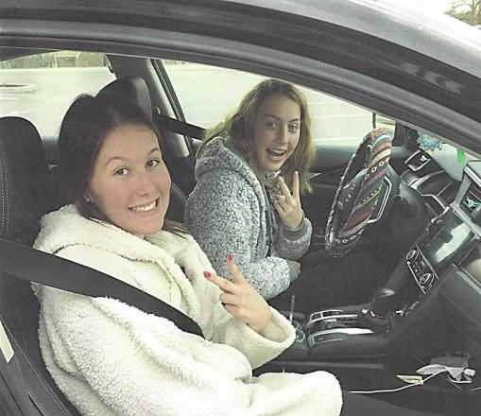
“Seatbelt Safety While Driving”
Dylan Harper
Benjamin Logan High School
Bellefontaine, OH

Slide 2
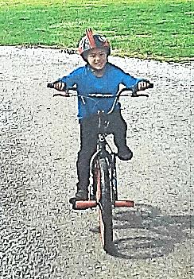
“A Helmet on Your Dome Will Help You Get Home”
Trevor Penwell
Benjamin Logan High School
Bellefontaine, OH

Slide 3
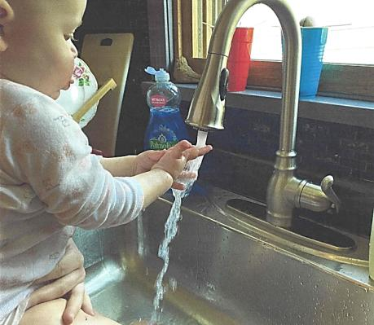
“Stay Inside and Wash Your Hands!”
Lily Harshfield
Benjamin Logan High School
Bellefontaine, OH

Slide 4
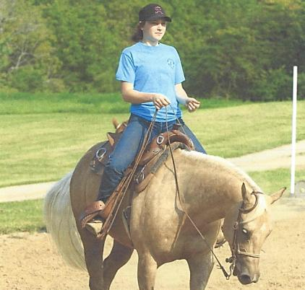
“Social Distancing by Riding to Keep the Community Safe”
Peyton Derr
Benjamin Logan High School
Bellefontaine, OH

Slide 5
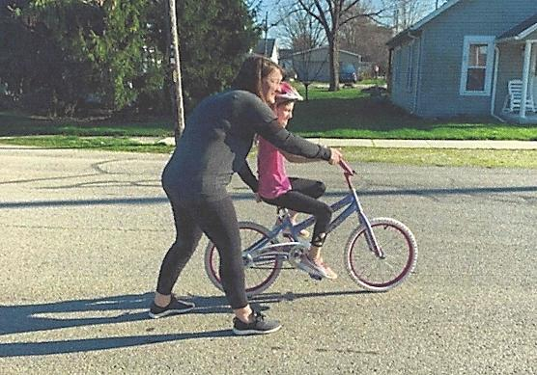
“Bicycle Safety-I Believe in You!”
Baylee Manns
Benjamin Logan High School
Bellefontaine, OH

Slide 6
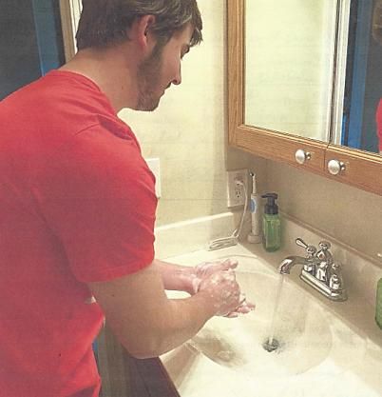
“Wash Your Hands…20 Seconds Could Save 20 Lives”
Ronald Gill
Benjamin Logan High School
Bellefontaine, OH

Slide 7

“Give Love to Your Street Signs”
Nicholas Rose
Benjamin Logan High School
Bellefontaine, OH

Slide 8
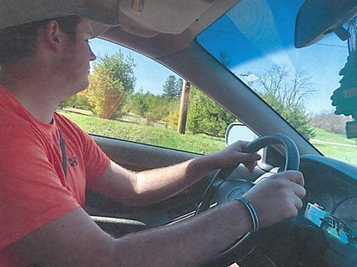
“Safe Driving with Two Hands on Wheel and Seat Belt”
Trey Allen
Benjamin Logan High School
Bellefontaine, OH

Slide 9
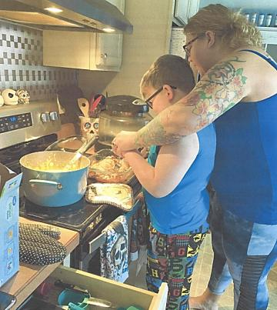
“Kitchen Safety-Loving Hands Teach Me How to be Safe”
Garrett Henry
Benjamin Logan High School
Bellefontaine, OH

Slide 10
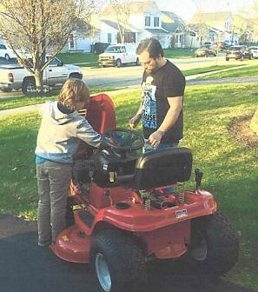
“My Father Didn’t Tell Me How to Live; He Lived, and Let Me Watch Him Do It”
Elaine McWade
Benjamin Logan High School
Bellefontaine, OH

Slide 11
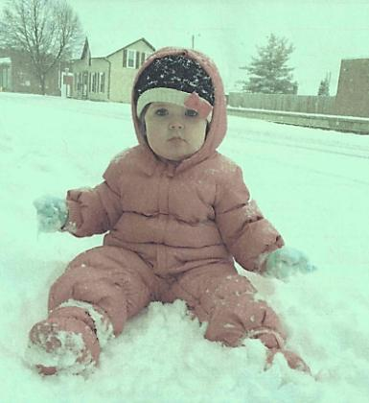
“Mommy Don’t Forget to Bundle Me Up!”
Ashley Ferguson
Anna High School
Anna, OH

Slide 12
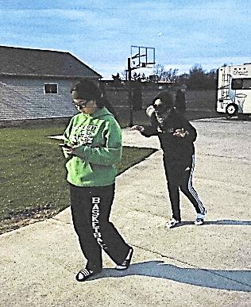
“Don’t Walk with a Blindfold or You Might Get Sold!”
Nylah Crosson
Anna High School
Anna, OH

Slide 13
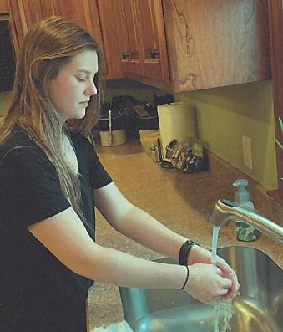
“Don’t Lose Hope, Just Wash Your Hands with Soap”
Macy Egbert
Anna High School
Anna, OH

Slide 14
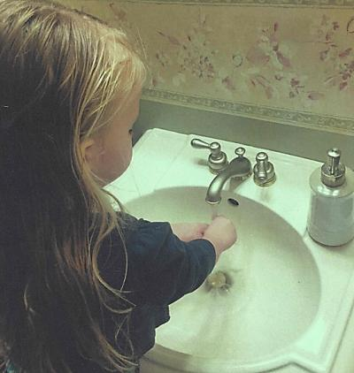
“Stop the Disease’s Plans by Taking Time to Wash Your Hands!”
Emily Bertke
Anna High School
Anna, OH

Slide 15
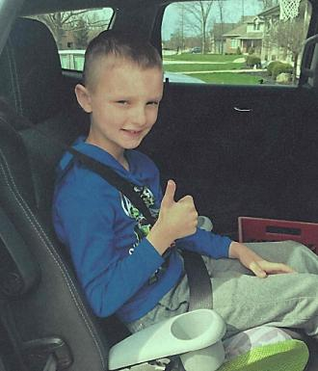
“My Booster Keeps Me Safe and Sound Until I’m 8 and 80 lbs.”
Bailey Althauser
Anna High School
Anna, OH

Slide 16

“If You Want to do Your Part…
Stay Apart!”
Michaela Ambos
Anna High School
Anna, OH

Slide 17
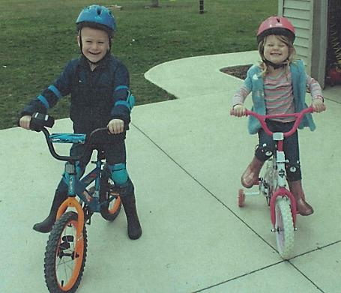
“Safety First, Prevents the Worst!”
Rachel Wells
Anna High School
Anna, OH

Slide 18
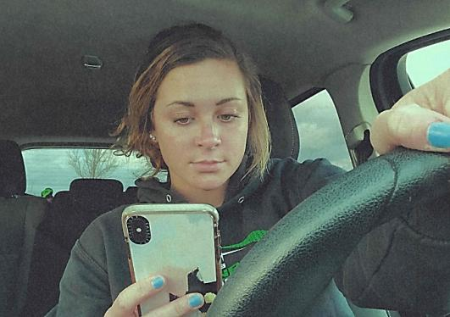
“Don’t Tempt Fate,
That Text Can Wait”
Carey White
Anna High School
Anna, OH

Slide 19
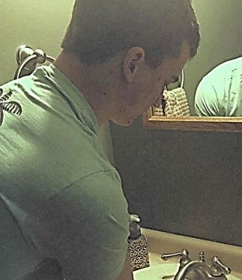
“To Stop the Spread of Covid-19…
Wash Your Hands for 20 Seconds and Stay Squeaky Clean!”
Ian Bollheimer
Anna High School
Anna, OH

Slide 20
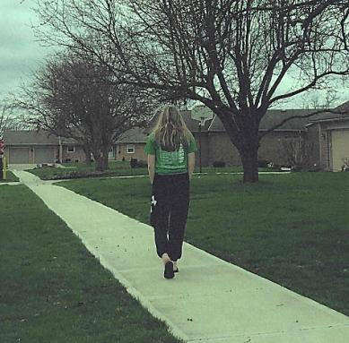
“Stolen Lives, Stolen Dreams…Avoid Walking Alone”
Emmaly Goguen
Anna High School
Anna, OH

Slide 21
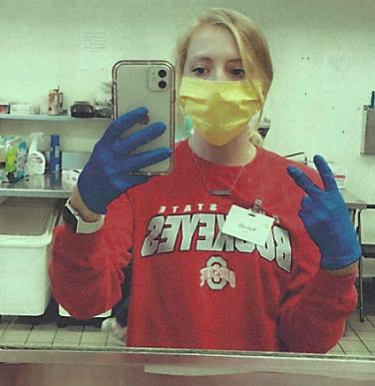
“Protect Others from Covid-19 by Protecting Yourself”
Sarah Ham
Anna High School
Anna, OH

Slide 22
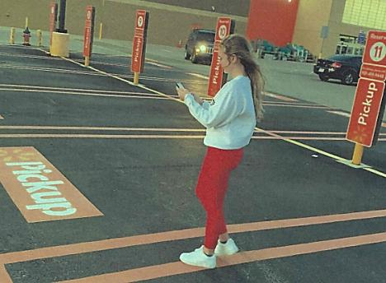
“Human Trafficking Happens Everywhere, So Stay Off Your Phone, Keep a Conscious Eye, to be Less Prone”
Kiplyn Rowland
Anna High School
Anna, OH

Slide 23
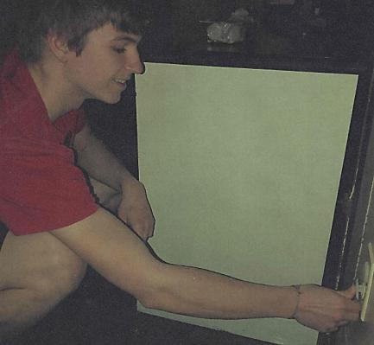
“Don’t Be Shocked When Your Baby Gets Hurt. Use Plug Protectors!”
Brenda Wuebker’s Student
Anna High School
Anna, OH

Slide 24
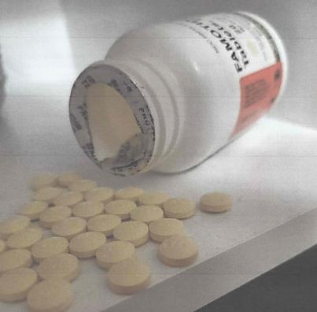
Stop it, Don’t Pop it…
Just Drop it!”
Macy Wiktorowski
Anna High School
Anna, OH

Slide 25
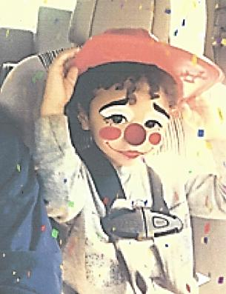
“Don’t Clown Around…
Buckle That Baby Up!
Macy Wiktorowski
Anna High School
Anna, OH

Slide 26
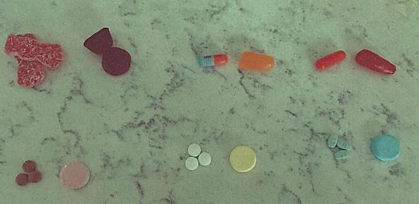
“Mom, Can I Have Candy?...
Candy Looks Like Medicine”
Maddie McEldowney
Anna High School
Anna, OH

Slide 27
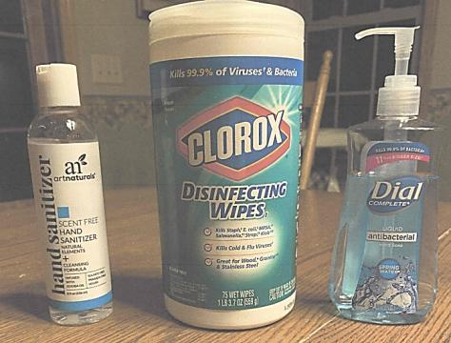
“Round Up the Troops
to Protect Us From Covid-19”
Lauren Elliott
Anna High School
Anna, OH

Slide 28
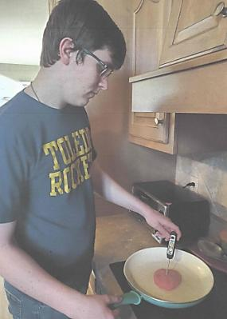
“Test Before You Ingest”
Dane Wuebker
Anna High School
Anna, OH

Slide 29
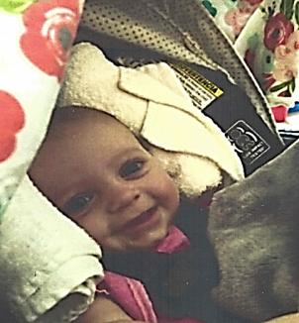
“Smiling My Way to Safety-
I Have the Best Parents!”
Alyssa Blangero
Mahoning County CTC
Canfield, OH

Slide 30
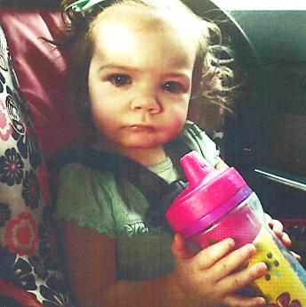
“Seriously…
You Wouldn’t Drive Off Without Buckling Me in First?”
Hailey Carmelo
Mahoning County CTC
Canfield, OH

Slide 31
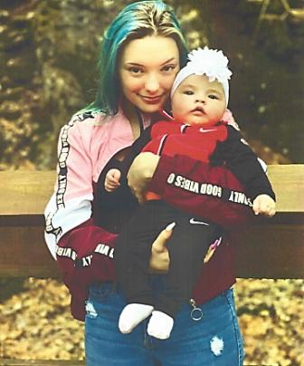
“Your Baby, in Safe Hands”
Annastasia Ashburn
Mahoning County CTC
Canfield, OH

Slide 32
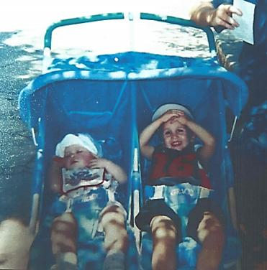
“No Matter the Age, Always be Safe and Buckle Up”
Klarissa Fox
Mahoning County CTC
Canfield, OH

Slide 33
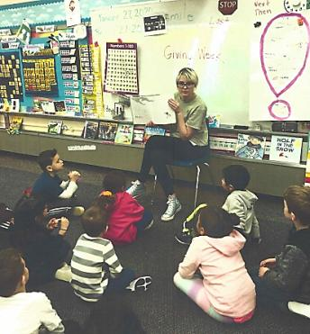
“Reading Peacefully is an Emotionally Safe Practice for Kindergarteners”
Kyah Ceci
Mahoning County CTC
Canfield, OH

Slide 34
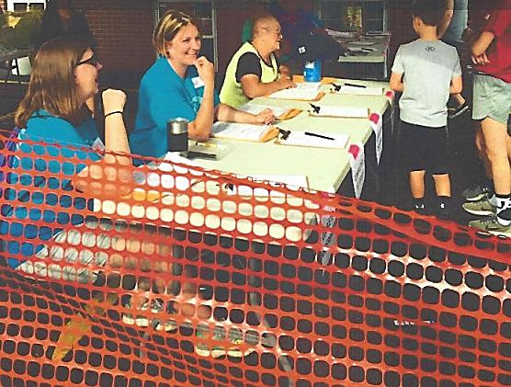
“Only Three Can Pick Me Up”
Laura Byler
Mahoning County CTC
Canfield, OH

