Slide 1
Kids in the Car – With Grandparents and Others Who Care
A safety presentation designed to save lives, avoid injuries, inform, and increase the effective safe seating of American children by their grandparents and other caregivers who drive them.
Sponsored by:
National Association of Women Highway Safety Leaders

Slide 2
We Must ACT Because Nationwide…
6 children are killed each day, over 2000 children each year.
Over 750 children are injured each day, almost 300,000 children with injuries.
Annual cost of childhood motor vehicle deaths and injuries exceeds $36 billion.

Slide 3
Newton’s First Law Of Motion
An object in motion
tends to remain in motion
at the original speed
unless it is acted upon
by an outside force.
An outside force:
A tree,
Steering wheel,
Instrument panel,
Etc.

Slide 4
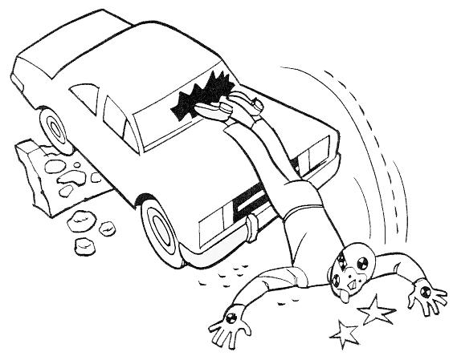
Three Types of Collisions
1st – Vehicle Collision
2nd – Human Collision
3rd – Internal Collision

Slide 5
Crash Forces
Weight x Speed =
Restraining Force Needed
50 lbs child at 40mph =
2000 lbs or 1 ton

Slide 6
5 Ways Restraints Prevent Injury
Prevent ejection
Contact the strongest
parts of the body
Spread force over a
wide area of the body
Help the body to
“ride down” the crash
Protect the head and
spinal cord

Slide 7
Child Safety Seat Effectiveness
Fatality Reduction
71% effective for infants, of 100 babies who died in crashes while not in a safety seat, 71 could have lived if IN a safety seat.
54% effective for toddlers, of 100 toddlers who died in crashes while not in a safety seat, 54 could have lived if IN a safety seat.
Reduces the need for hospitalization by 69%.

Slide 8
Child Protection Seat Issues
No safety seat = 56%
Misuse or incorrect installation
National Average = 80%
Northern California AAA reports misuse:
84% in San Francisco Area
Often 100% before CPS Programs
Drops to 80% after CPS Programs
Incompatibility with vehicle

Slide 9
Questions?
What size should I buy?
How can I be sure my child is safe?
How do I make sure it fits?
What brand?
Rear facing?
Forward facing?
Booster?
Where can I get more information?

Slide 10
Which Seat is Best for my child?

Slide 11
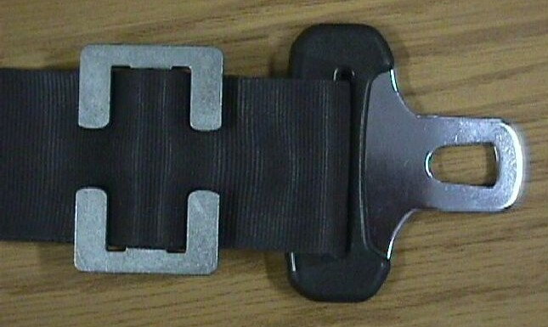
Know Your Seatbelt Style
What type of latch plate?
What type of retractor?
What type of locking clip?

Slide 12
Recommendations:
Proper Child Safety Seat Use Chart. Buckle Everyone. Children Age 12 and Under in Back!
 | INFANTS | TODDLER | YOUNG CHILDREN
WEIGHT | Birth to 1 year at least 20-22 lbs. | Over 1 year and Over 20 lbs.-40 lbs. | Over 40 lbs. Ages 4-8, unless 4'9''.
TYPE OF SEAT | Infant only or rear-facing convertible | Convertible / Forward-facing | Belt positioning booster seat
SEAT POSITION | Rear-facing only | Forward-facing | Forward-facing

Slide 13
Recommendations:
Children should remain rear-facing until they are at least one year old AND weigh at least 20 pounds.
Children over one year of age who weigh between 20 and 40 pounds should ride in a forward-facing child restraint with a full harness until 40 pounds.
Children should ride in booster seats until they are 4’9” tall.

Slide 14
How Can You Help?
Volunteer at car seat check up events.
Take your children
Invite other families to participate.
Sponsor an event at church, community center, school, or mall.
Support stronger safety laws, increased enforcement, education.

Slide 15
Car Seat Checkup Events
January 12th, 2002 in Chattanooga, TN:
32 car seats checked
Only 2 were correctly installed
89 total corrections recorded
100% misuse for children under 4 years and 40 lbs.
7 new seats given away
February 16th, 2002 in Cleveland, TN:
82 car seats checked
only 1 was correctly installed
23 seats given away

Slide 16
Where Do I Go For Help?
People – Find the experts
Certified technicians
Child Safety Seat Inspection Stations
Programs
Publicly funded like NHTSA
Privately funded like NAWSL
Resources
State Highway Safety Office
Websites

Slide 17
Inspection Station Referral
People who can help
Inspection Stations found in Louisiana (LA).
Safety Council of the Louisiana Capitol Area 8180 Siegen Lane Baton Rouge, LA 70810 phone: 225-766-0955 Ext- 134 Kim Watts
Louisiana Passenger Safety Services, Inc. 502 Berard Street Breaux Bridge, LA 70517 phone: 337-332-6065 Edna Guilbeaux
St. Tamany Parish Sheriff’s Office 1180 Champagne Street Covington, LA 70433 phone: 504-875-2616 Sterling Hebert
Ralph Sellers Chry-Ddg-Jeep 14215 N. Airline Highway Gonzales , LA 70737 phone: 2256447542
www.nhtsa.com/
To access
the regional
web pages,
just click on
a State or Region!

Slide 18
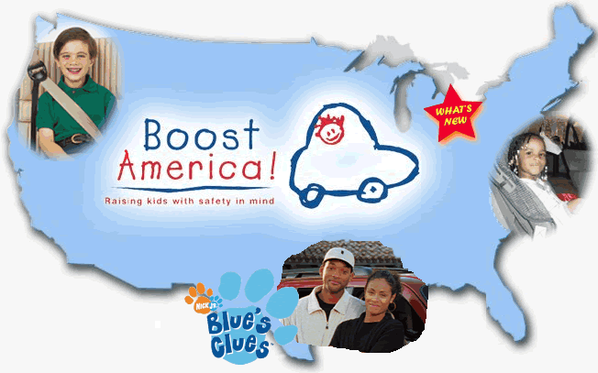
Public and Private Programs
SafetyBeltSafe U.S.A.

Slide 19
Resources
AAA Foundation for Traffic Safety
www.aaafoundation.org
American Automobile Association
www.aaa.com
American Academy of Pediatrics
www.aap.org
Children’s Hospital of Philadelphia
www.chop.edu
Insurance Institute for Highway Safety
www.highwaysafety.org
National Highway Traffic Safety Administration (NHTSA)
Hotline: 1-888-DASH-2-DOT
www.nhtsa.dot.gov
National Safety Belt Coalition
www.carseat.org

Slide 20
Child Passenger Safety
Remember:
Set a good example – Buckle Up!
Start the car when everybody’s buckled.
All kids under 13 in the back seat.
Choose the seat that fits your child.

Slide 21
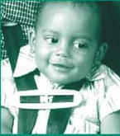
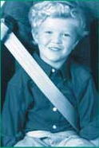
They’re Counting On YOU!

Slide 22
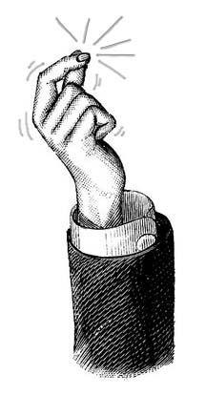
It could happen in an instant…
And it’s up to you.

