Slide 1
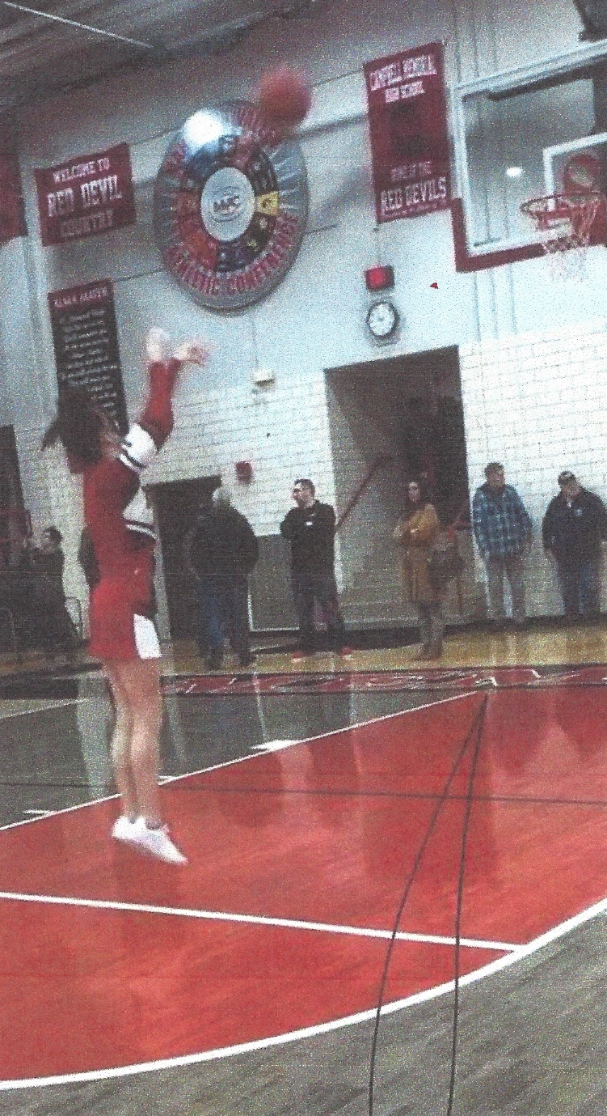
“Aim for the Right Kind of High”
Kylie Gillespie
Mahoning County Career & Technical Center
Campbell, OH

Slide 2
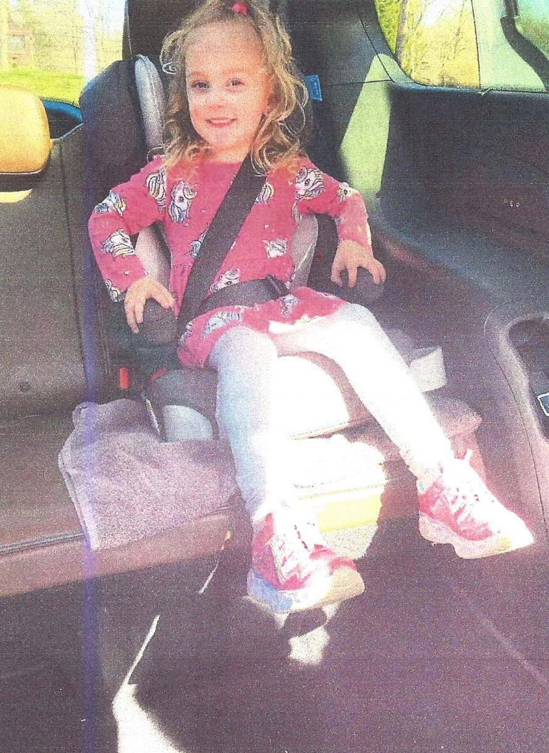
“Lead the Way, Safety Today”
Rebecca Toth
Mahoning County Career & Technical Center
Austintown, OH

Slide 3
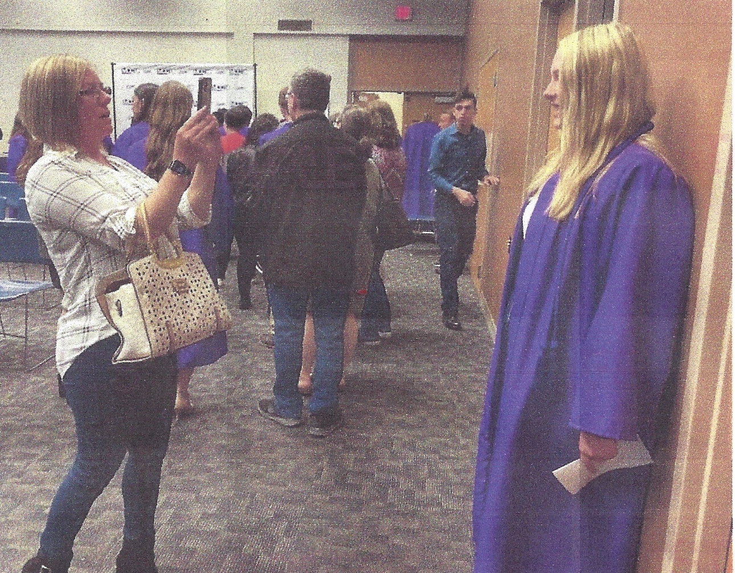
“There are Lots of Twists, Turns, and Bumps in the Road on the Journey through Life . . . Being There through it All is What Matters!”
Brianna Miller
Mahoning County Career & Technical Center
North Lima, OH

Slide 4
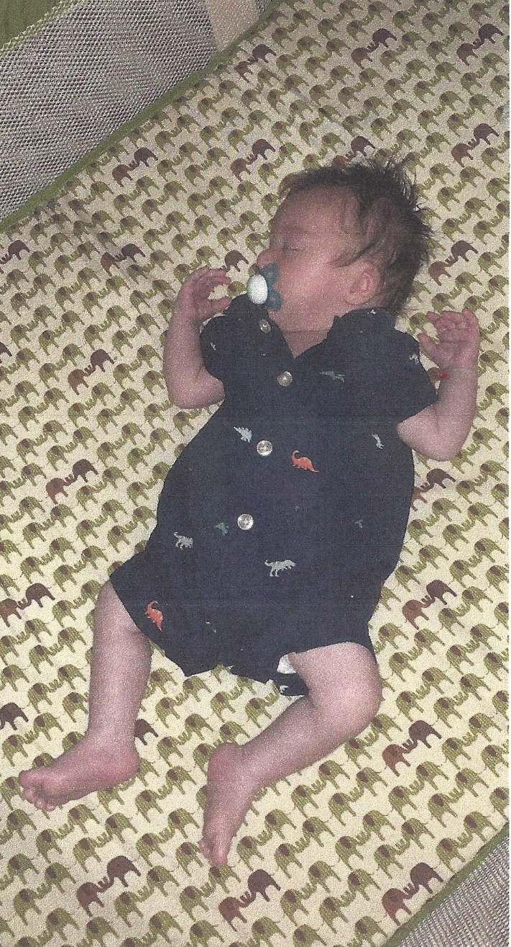
“Safer Sleep for Every Sleep”
Madison Carroll
Mahoning County Career & Technical Center
Alliance, OH

Slide 5
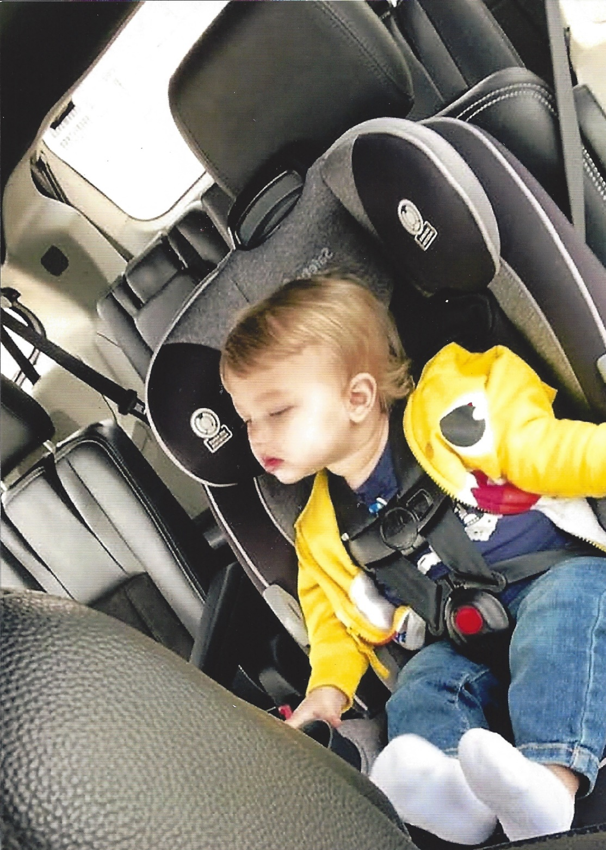
“Mom’s Cruising So Baby Can Stay Snoozing!”
Shelby Puckett
Upper Valley Career Center
Piqua, OH

Slide 6
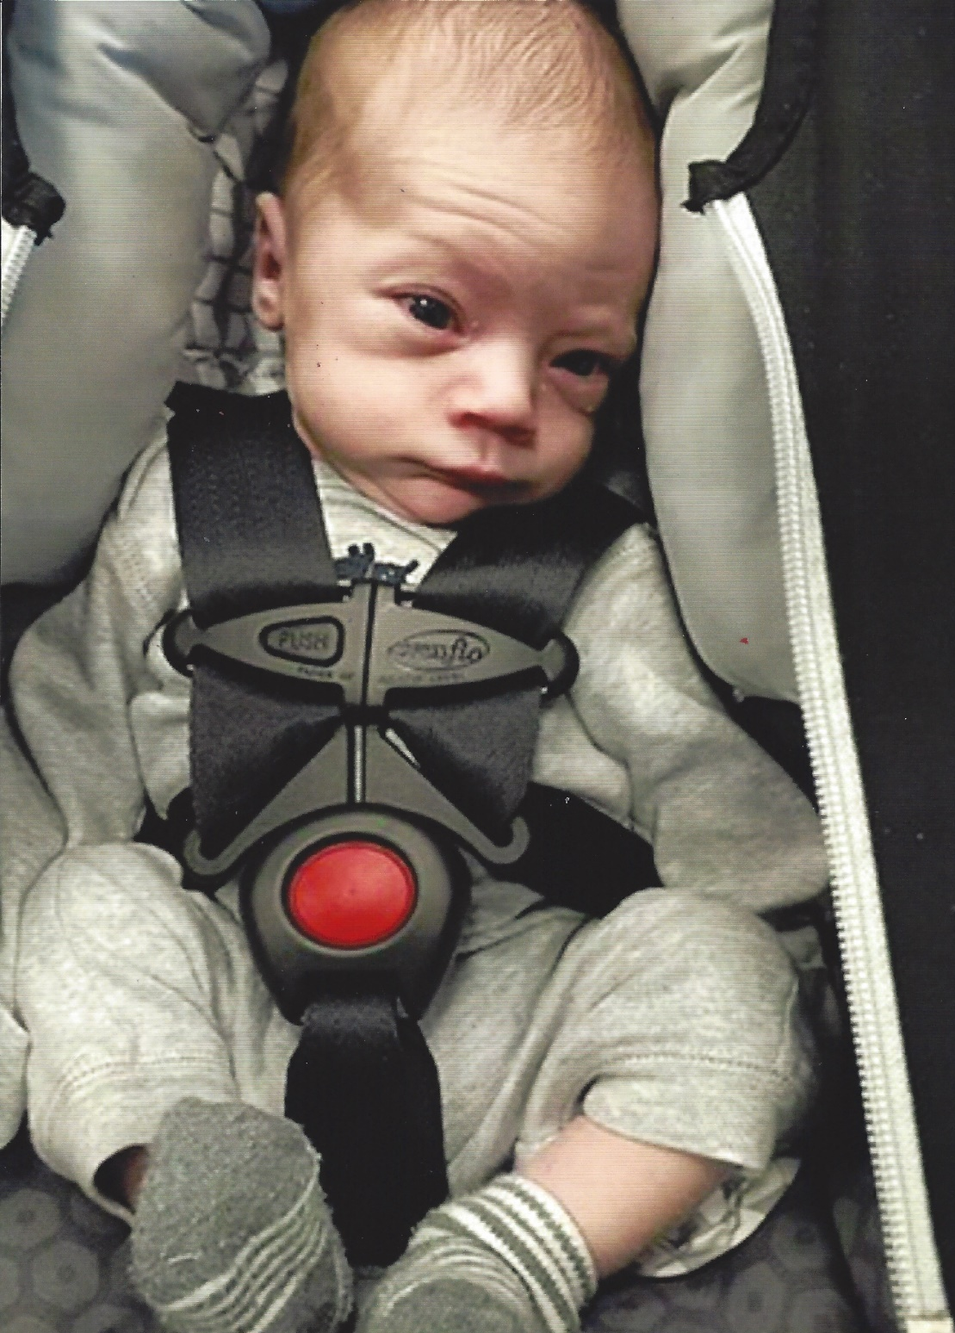
“Click It or Ticket . . . No Worries for Me”
Ethan Norman Ray Sherry
Upper Valley Career Center
Troy, OH

Slide 7
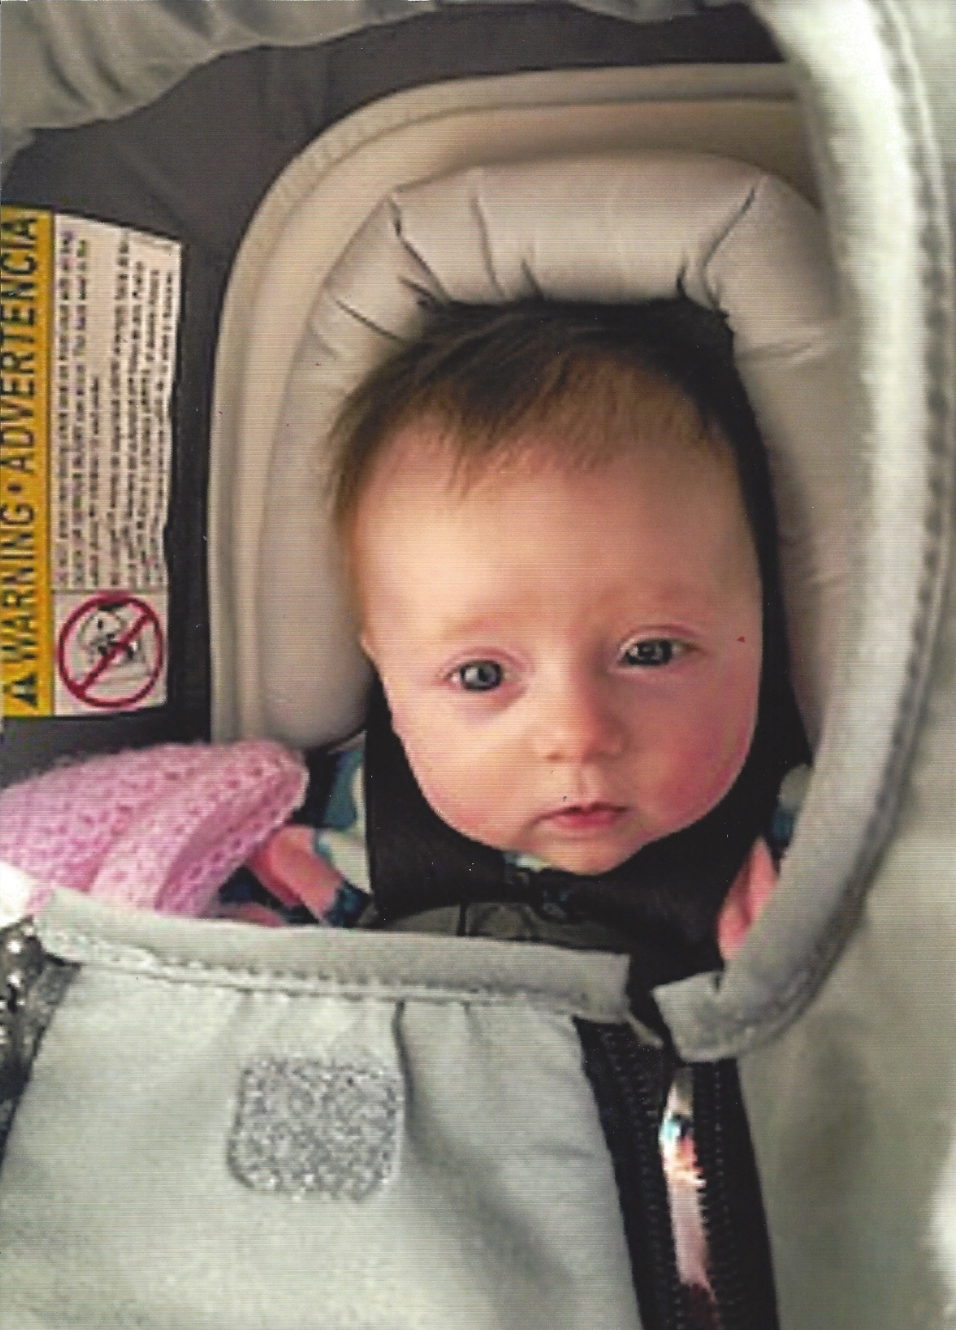
“Safety for Me Is As Easy As Can Be!”
Jory Brussell
Upper Valley Career Center
Troy, OH

Slide 8
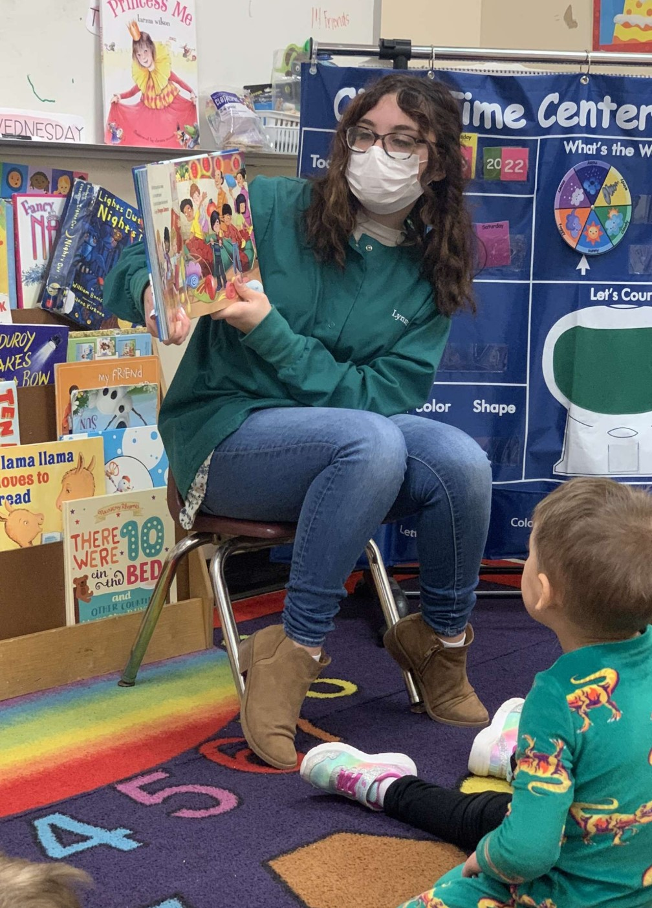
“Masking Up Protects Those You Care For and Those You Care About”
Lynnz Gonzalez
Mahoning County Career & Technical Center
Boardman, OH

Slide 9
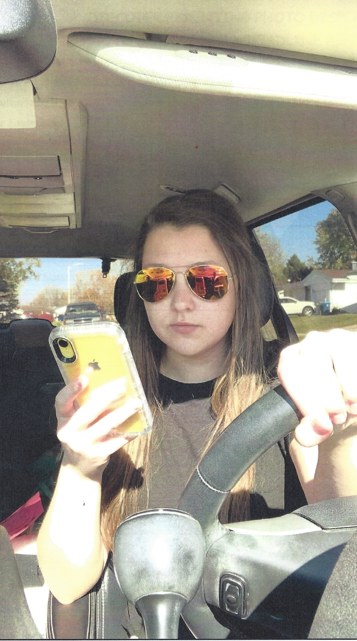
“No Text is Worth a Death”
Kayleigh Davidson
Anna High School
Sidney, OH

Slide 10
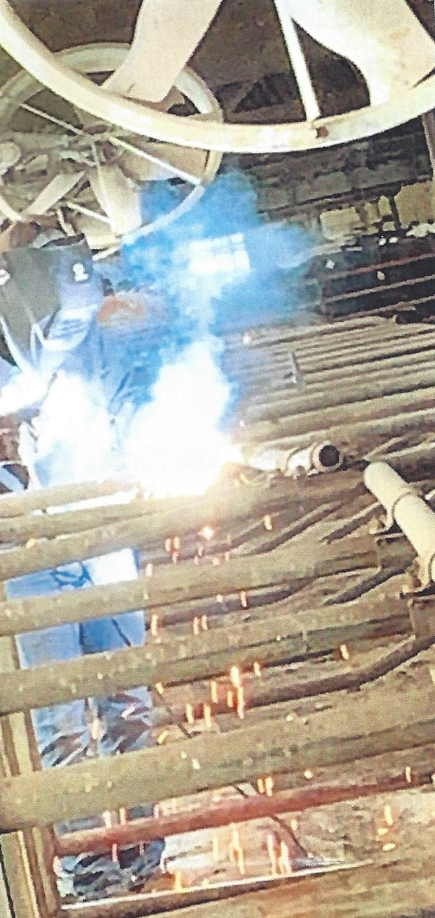
“Put the Phone Down and Weld New Hobbies Within You”
Brandon Axe
Anna High School
Anna, OH

Slide 11
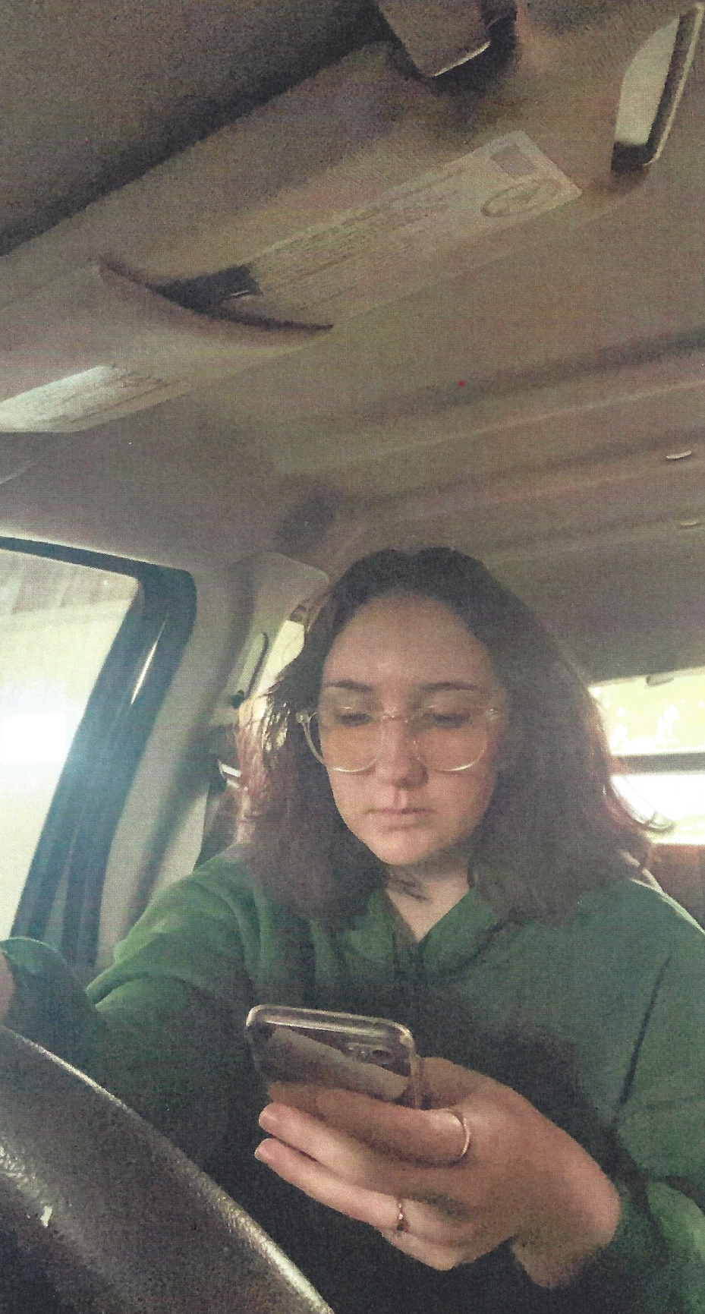
“Nothing is More Important than Your Life”
Kaitlin Rickert
Anna High School
Ketterlersville, OH

Slide 12
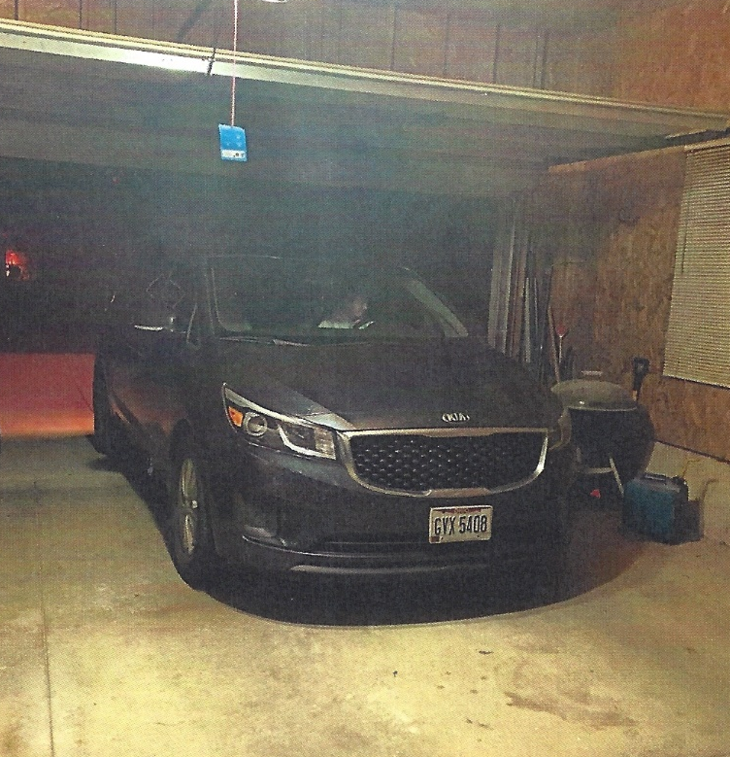
“Make Sure You Pull Your Car Outside So You Don’t Poison Yourself from Carbon Monoxide”
Taylor Poeppelman
Anna High School
Sidney, OH

Slide 13
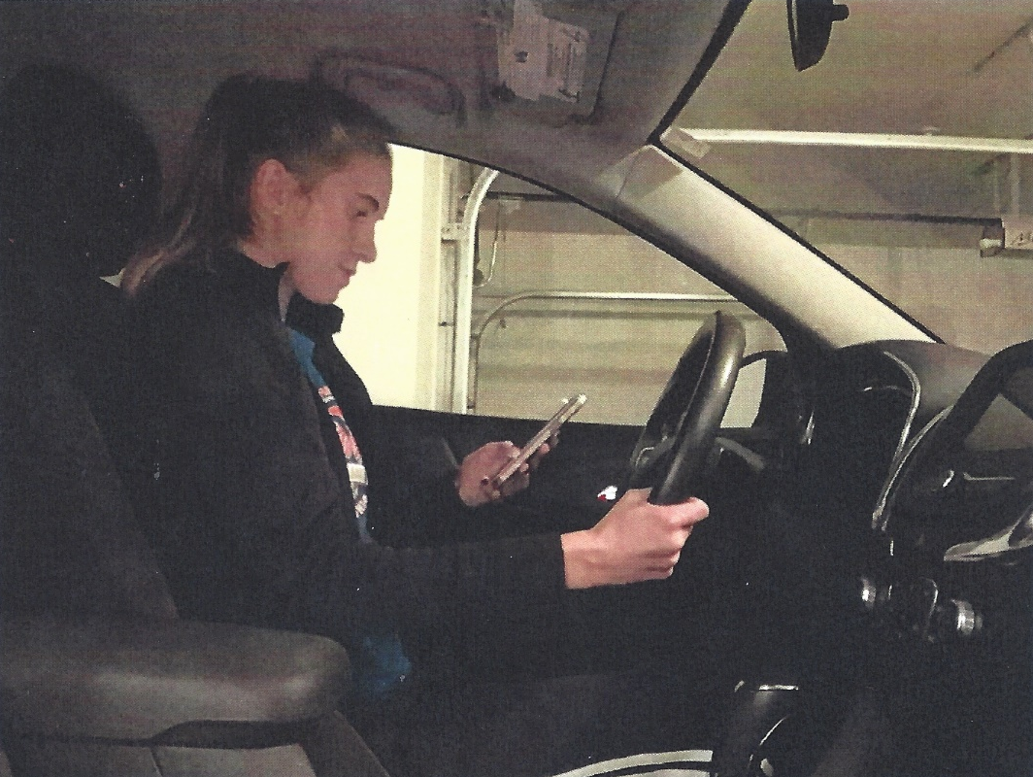
“Is Your Text More Important Than Your Life?”
Abbie McEldowney
Anna High School
Anna, OH

Slide 14
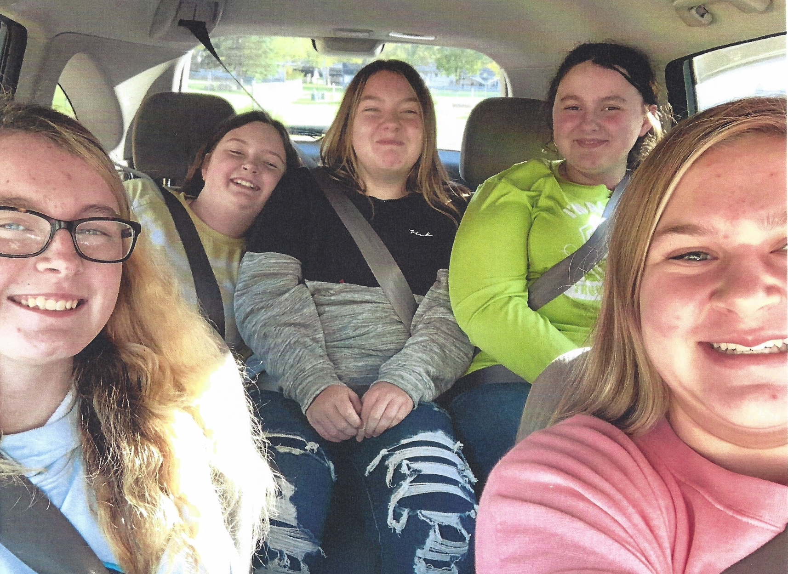
“No Matter How Far, No Matter Whose Car, Always Buckle Up”
Aubrie Coyer
Anna High School
Anna, OH

Slide 15
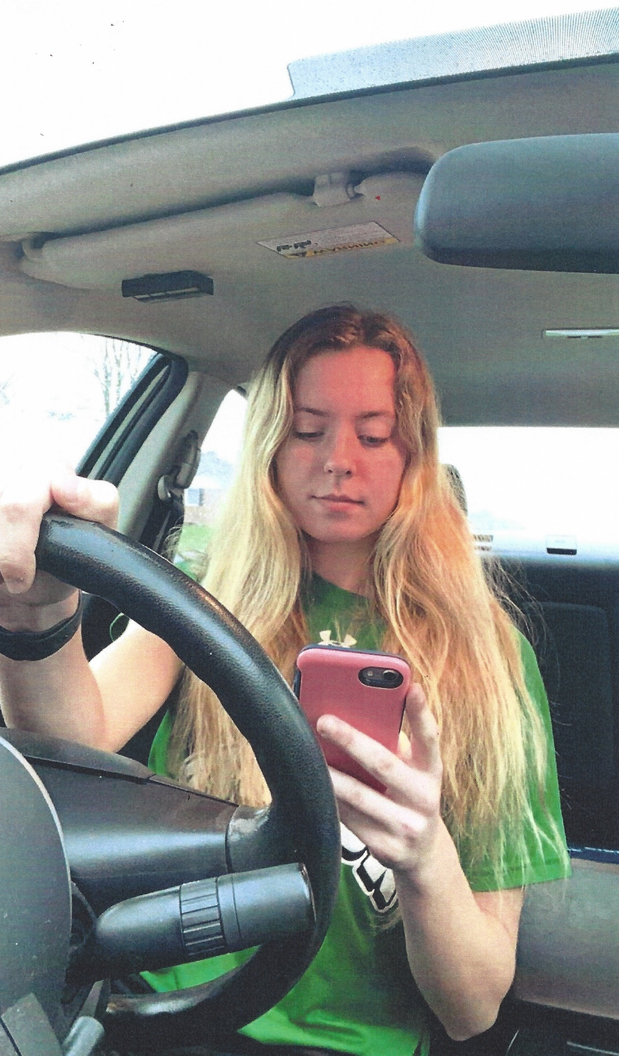
“When You’re Distracted, Who’s Driving?”
Ashley Bertke
Anna High School
Anna, OH

Slide 16
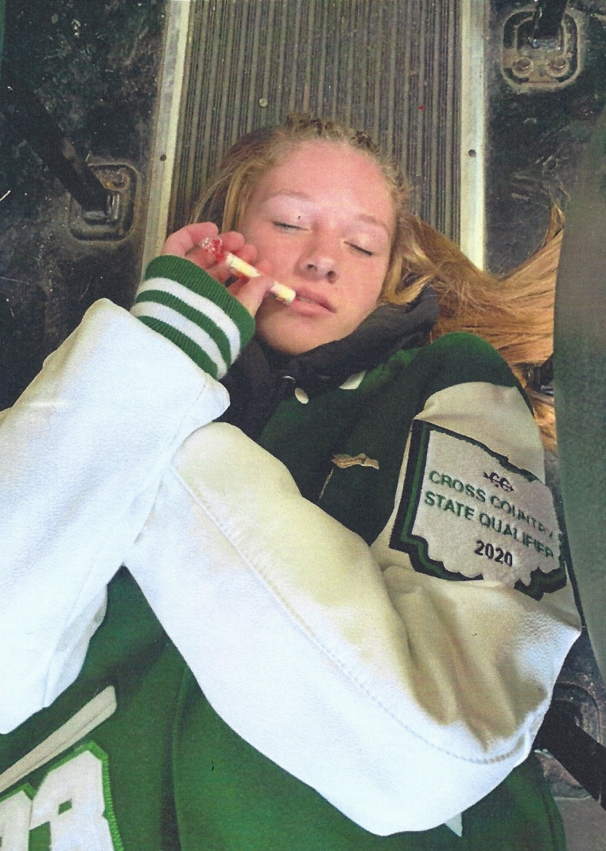
“Smoking Helps You Relax in the Graveyard”
Grace Bensman
Anna High School
Anna, OH

Slide 17
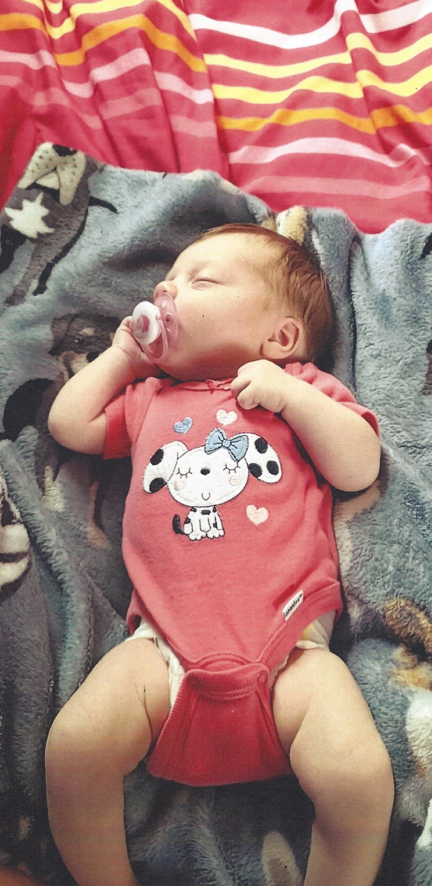
“Safe Sleep is Kool”
Alisha Cruse
Anna High School
Sidney, OH

Slide 18
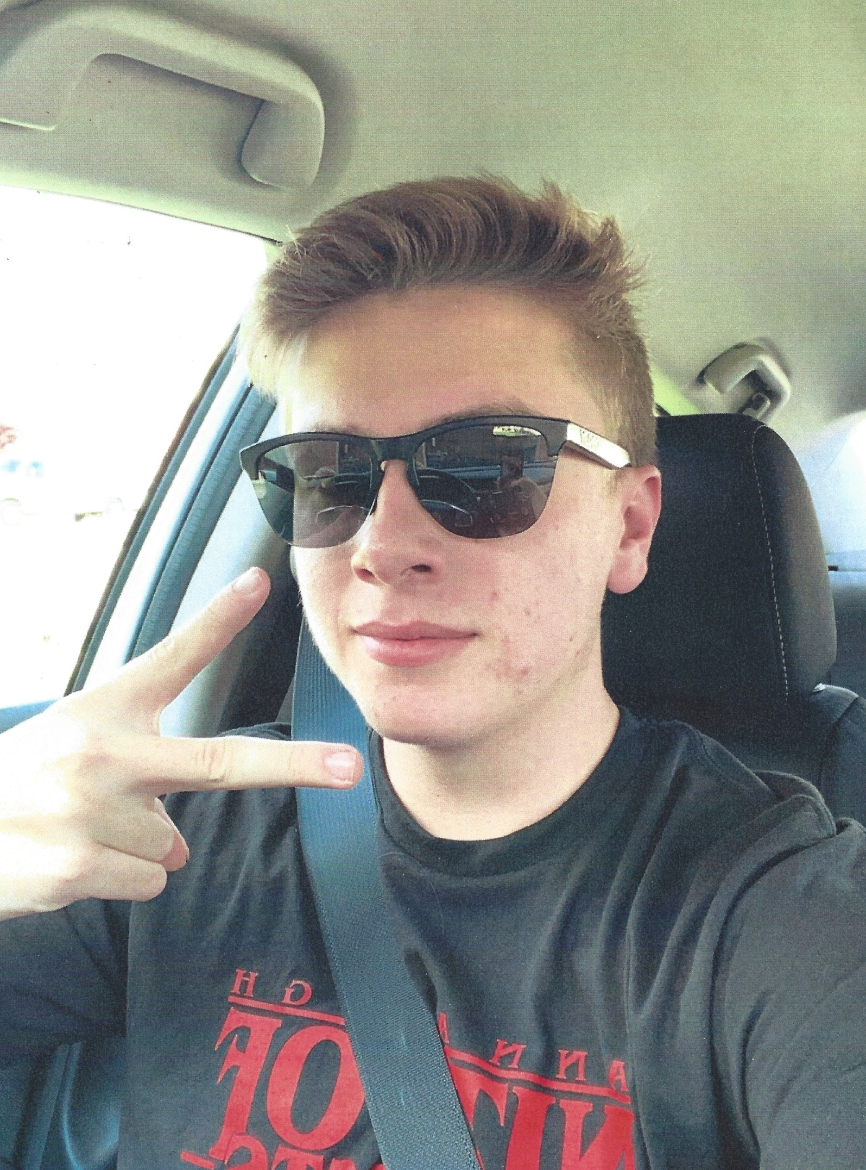
“Safety is the New Cool”
Luke Dodds
Anna High School
Anna, OH

Slide 19

“Stay Safe & Bike on the Right”
Brooke Pettus
Anna High School
Botkins, OH

Slide 20
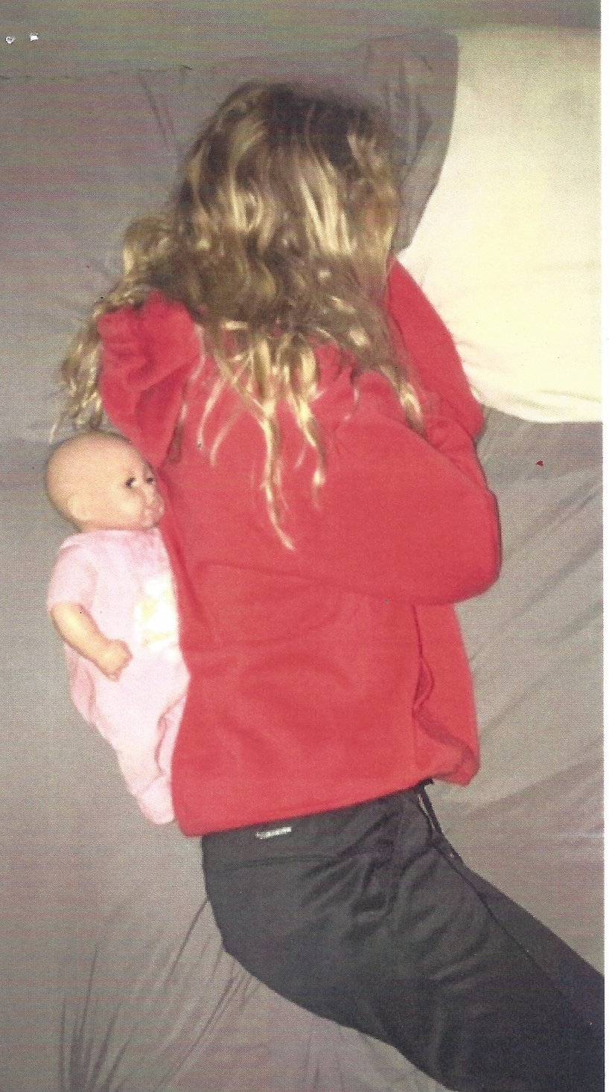
“Don’t Become a Statistic, Never Sleep with Your Baby”
Gabby Myers
Anna High School
Anna, OH

