Slide 1
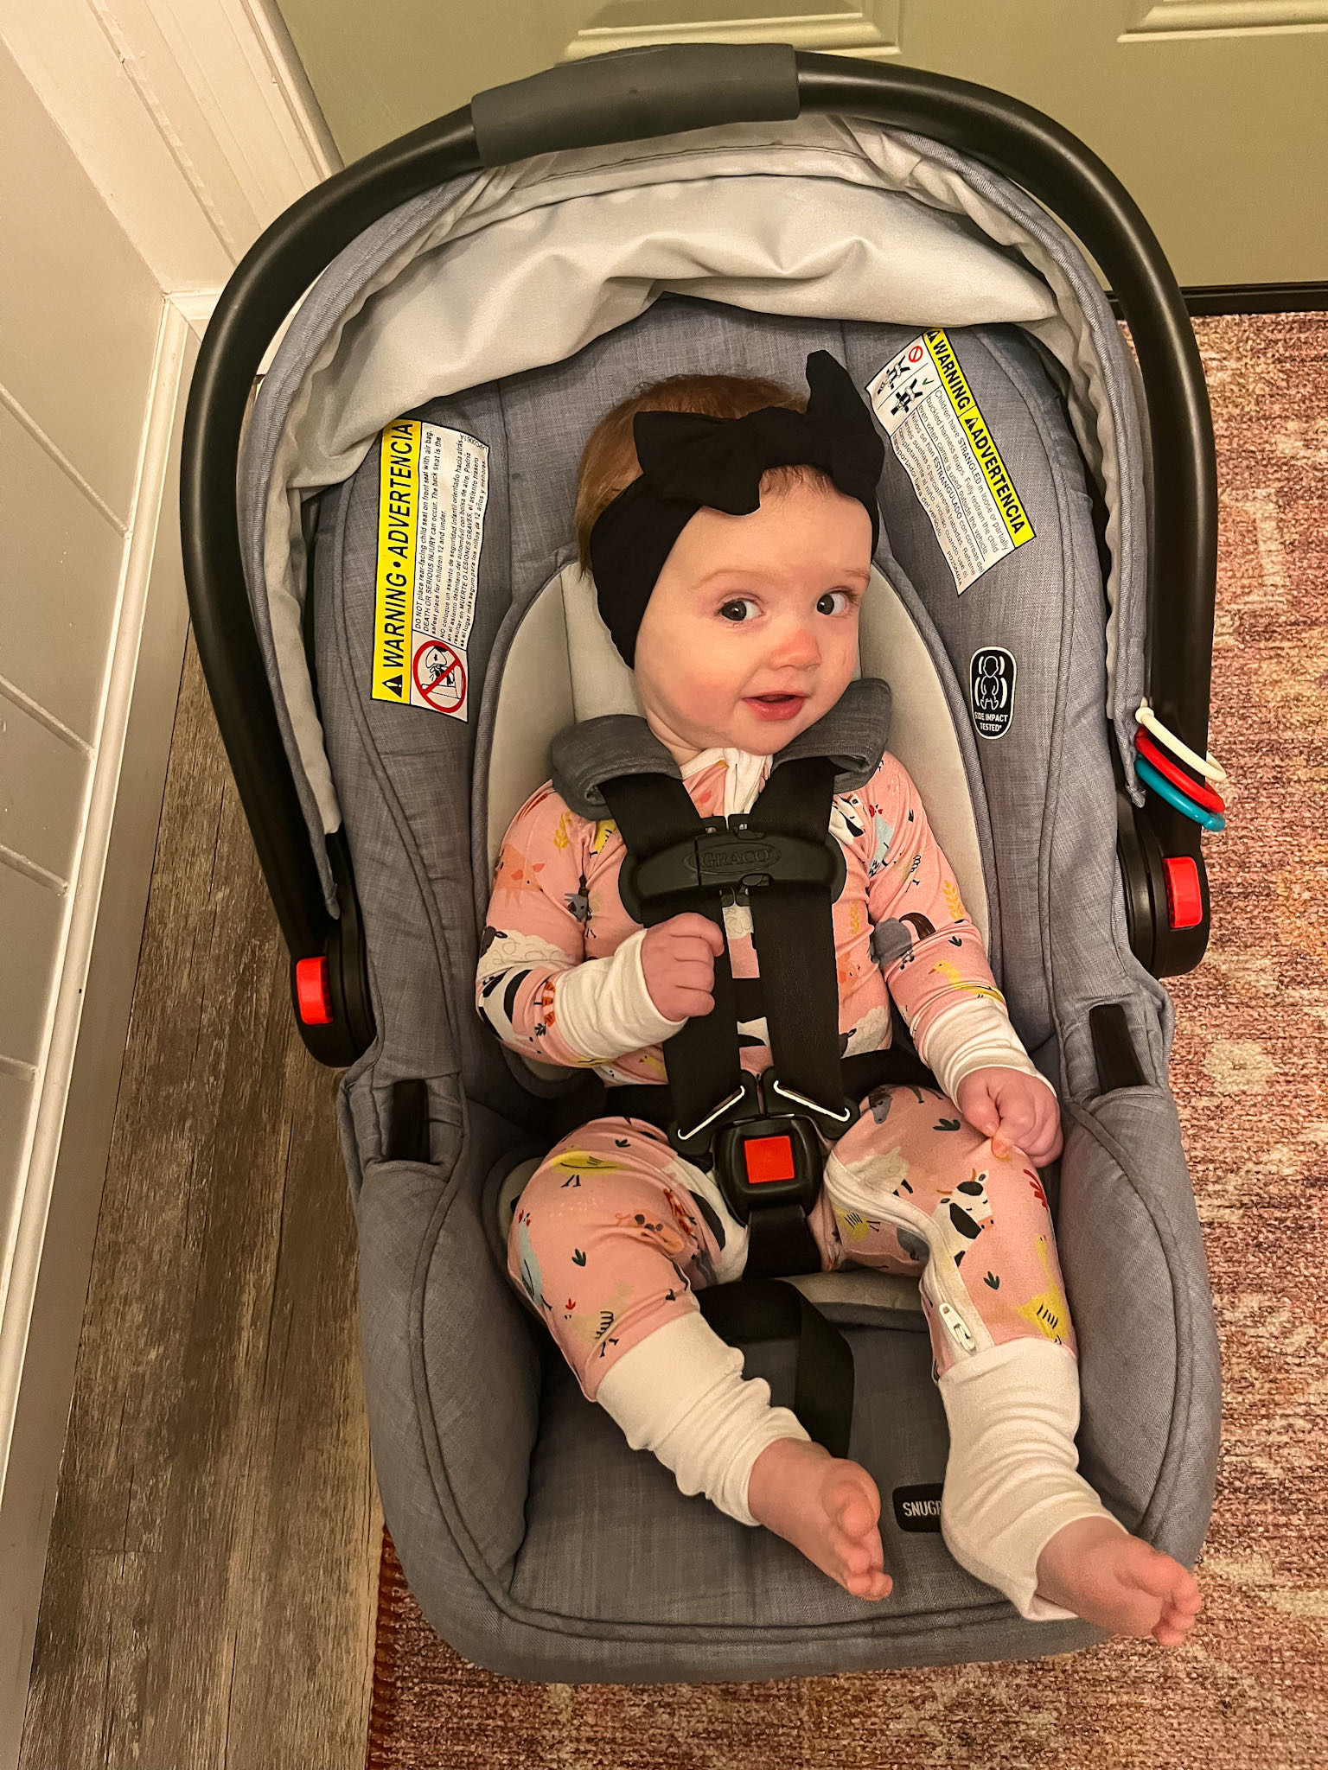
“Buckle at the Chest is Where it Should Rest”
Brynn Schmite
Anna High School
Anna, OH

Slide 2
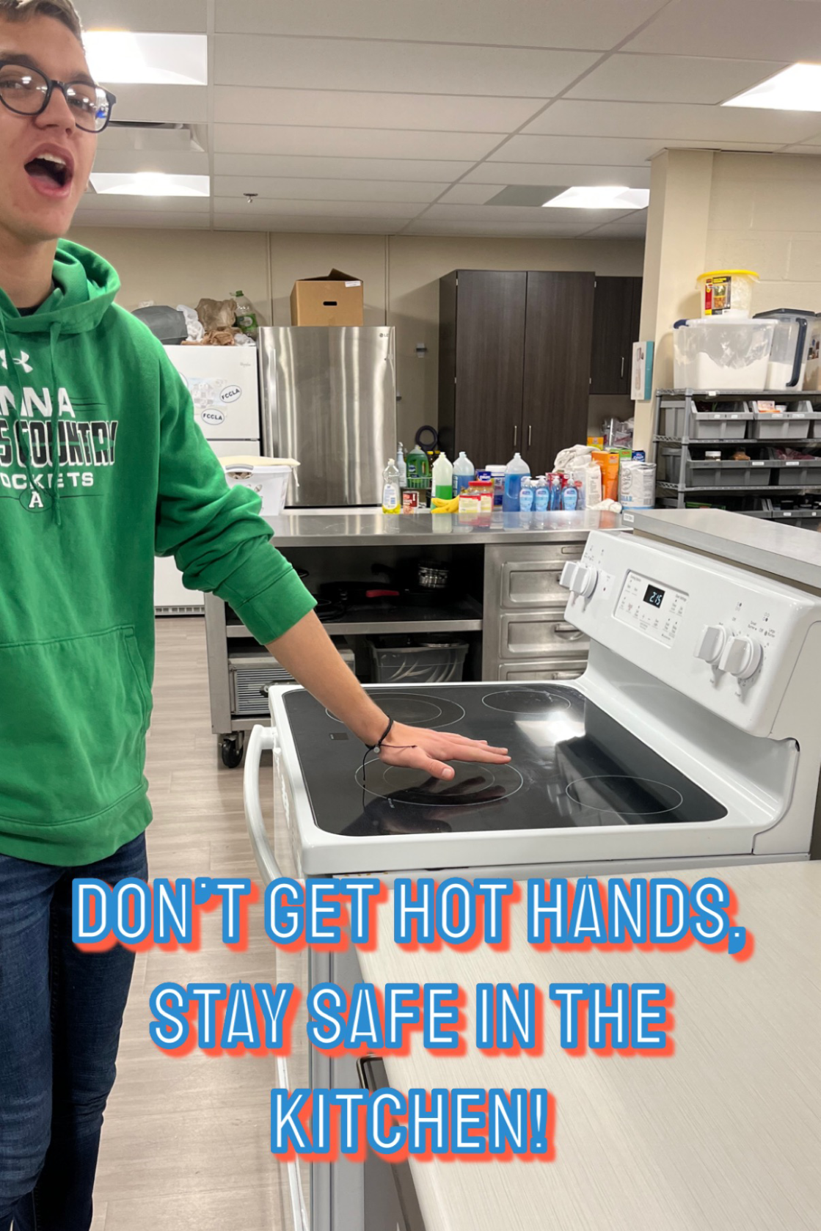
“Don’t Get Hot Hands, Stay Safe in the Kitchen!”
Maddox Deeren
Anna High School
Sidney, OH

Slide 3
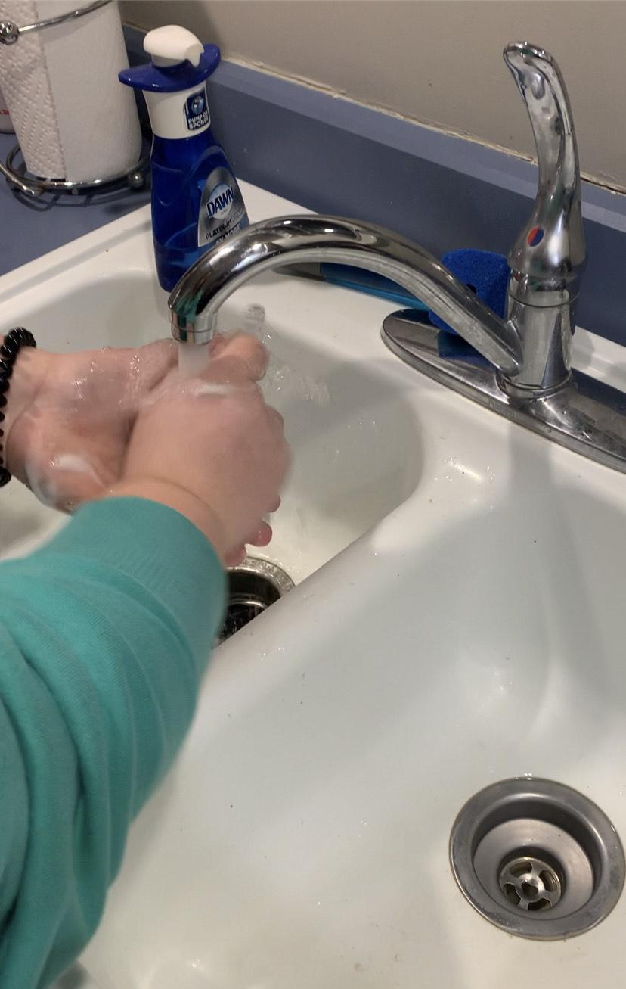
“Wash Your Hands So the Germs Don’t Expand”
Taylor Dye
Anna High School
Sidney, OH

Slide 4
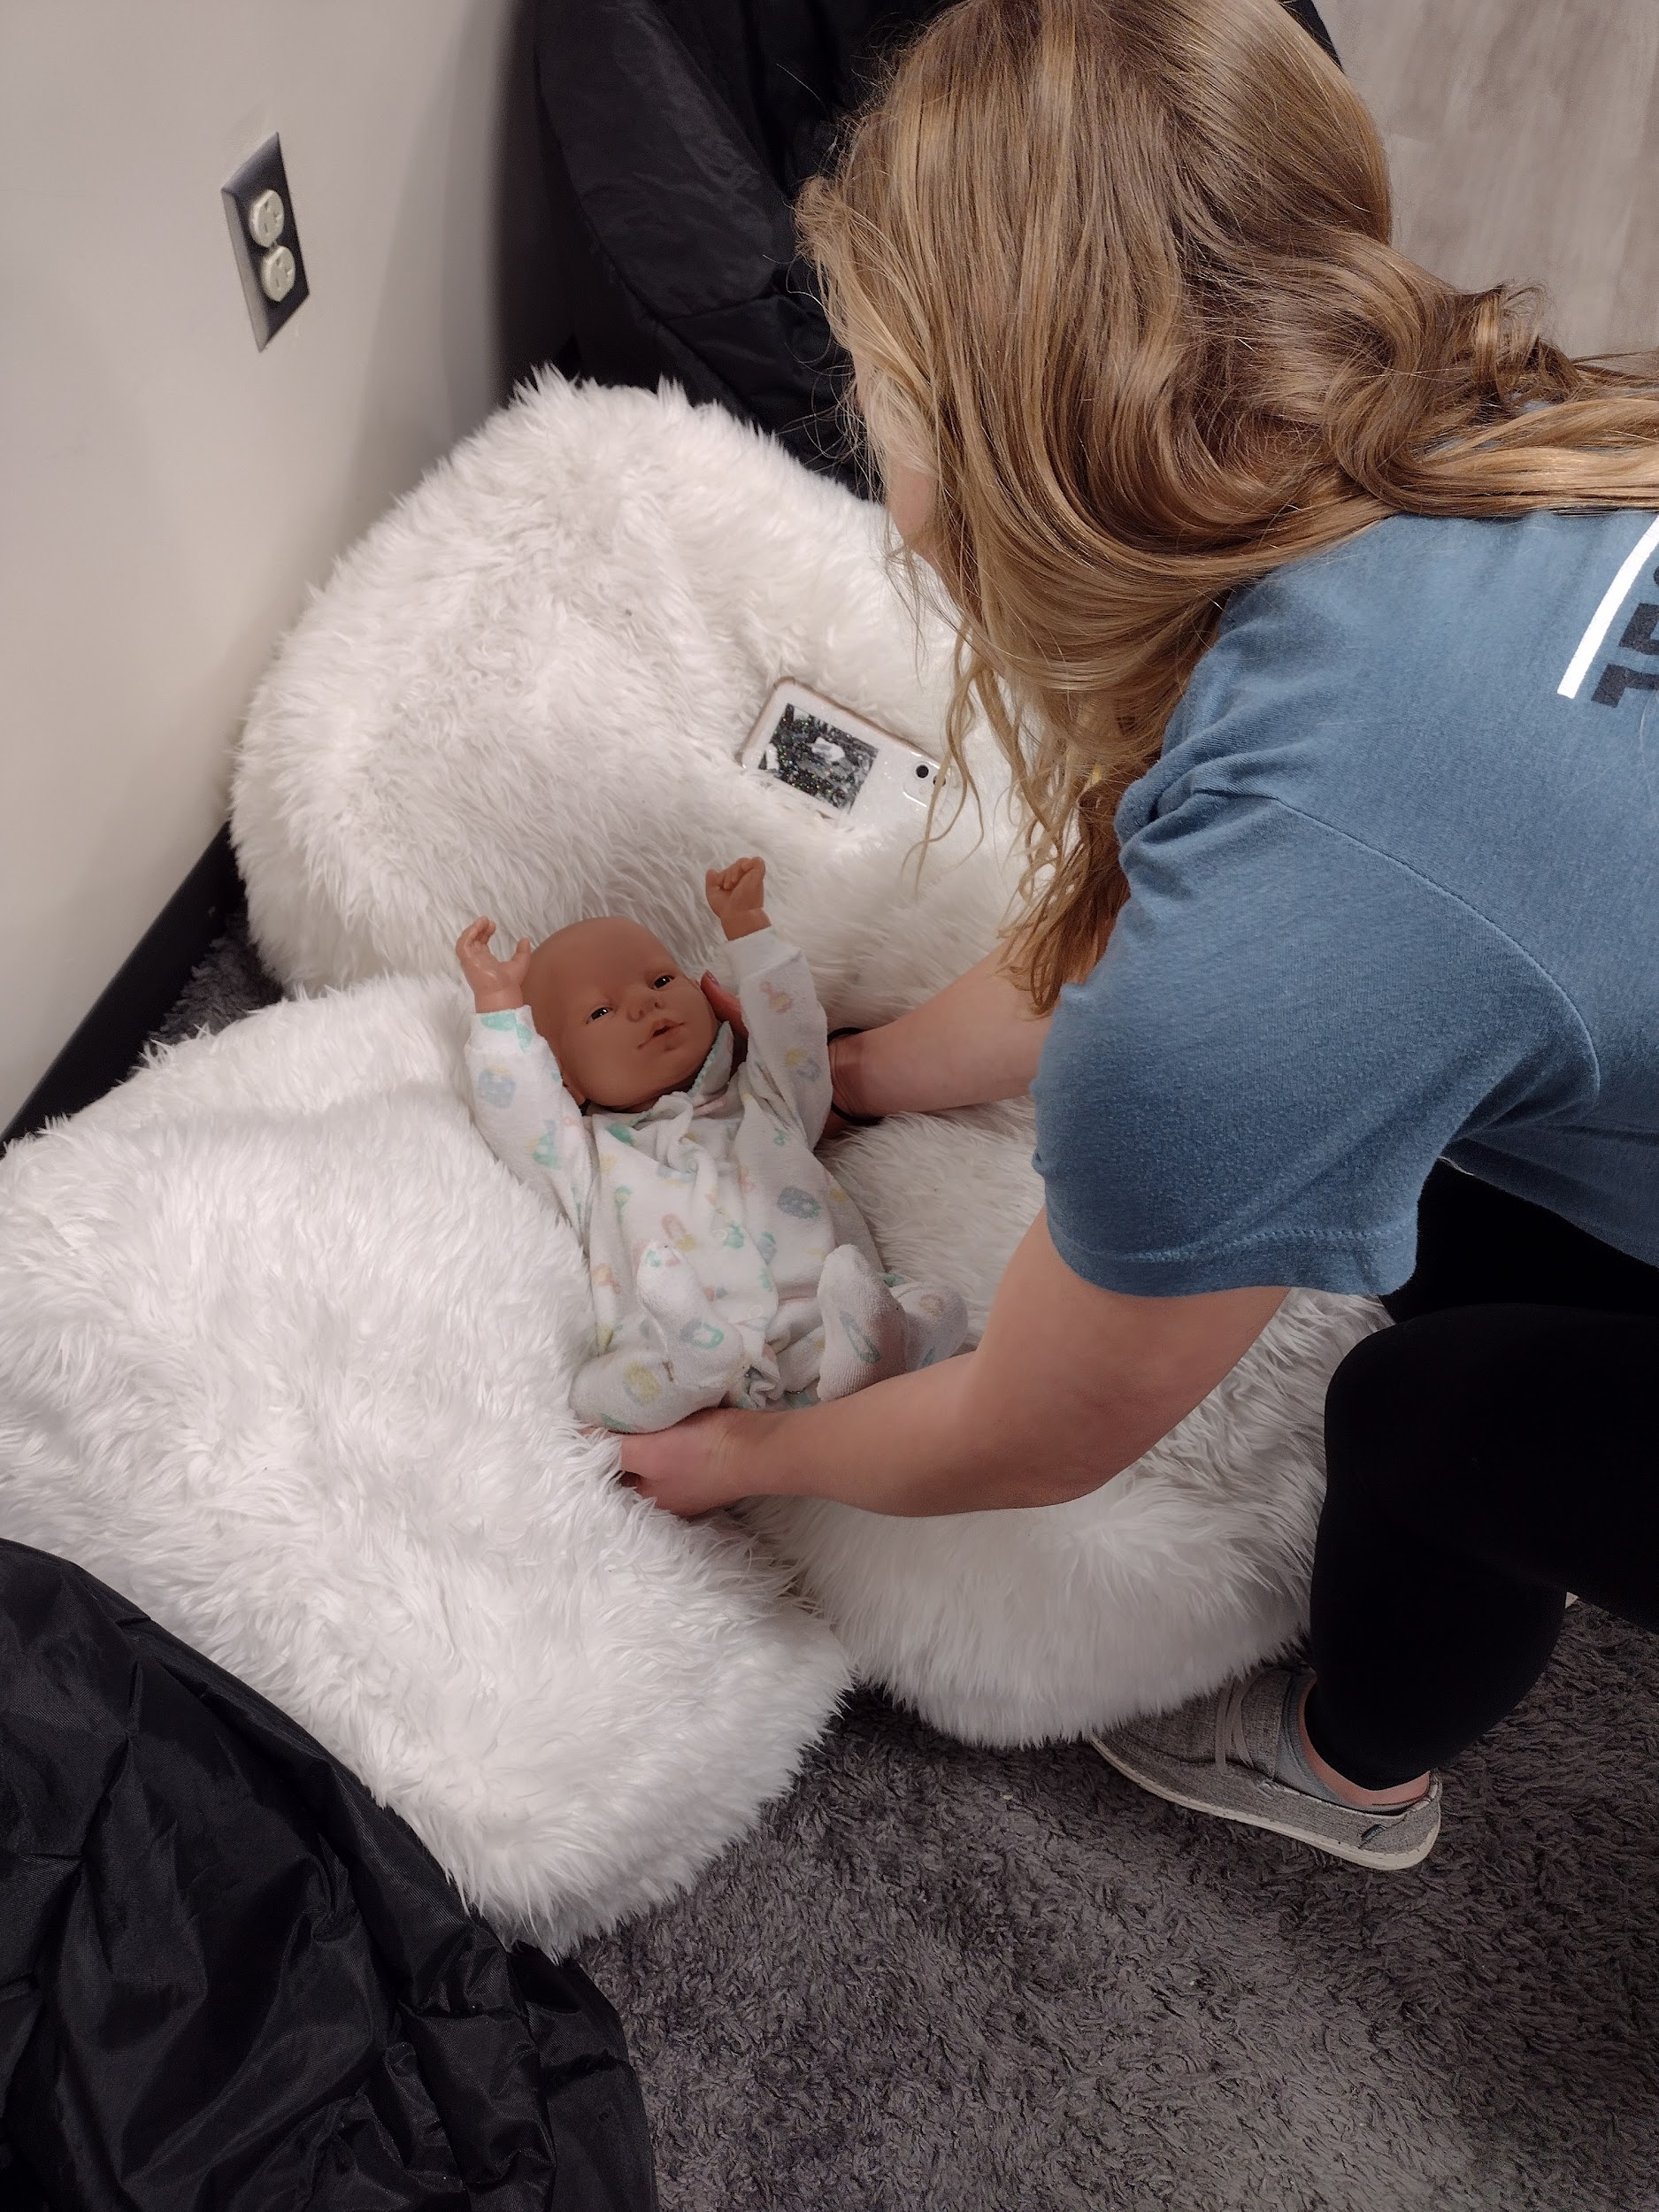
“Put the Baby Down So You Can Calm Down”
Abigail George
Anna High School
Anna, OH

Slide 5
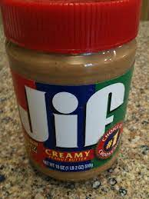
“Be Aware of Allergies”
Christian Mahan
Anna High School
Anna, OH

Slide 6
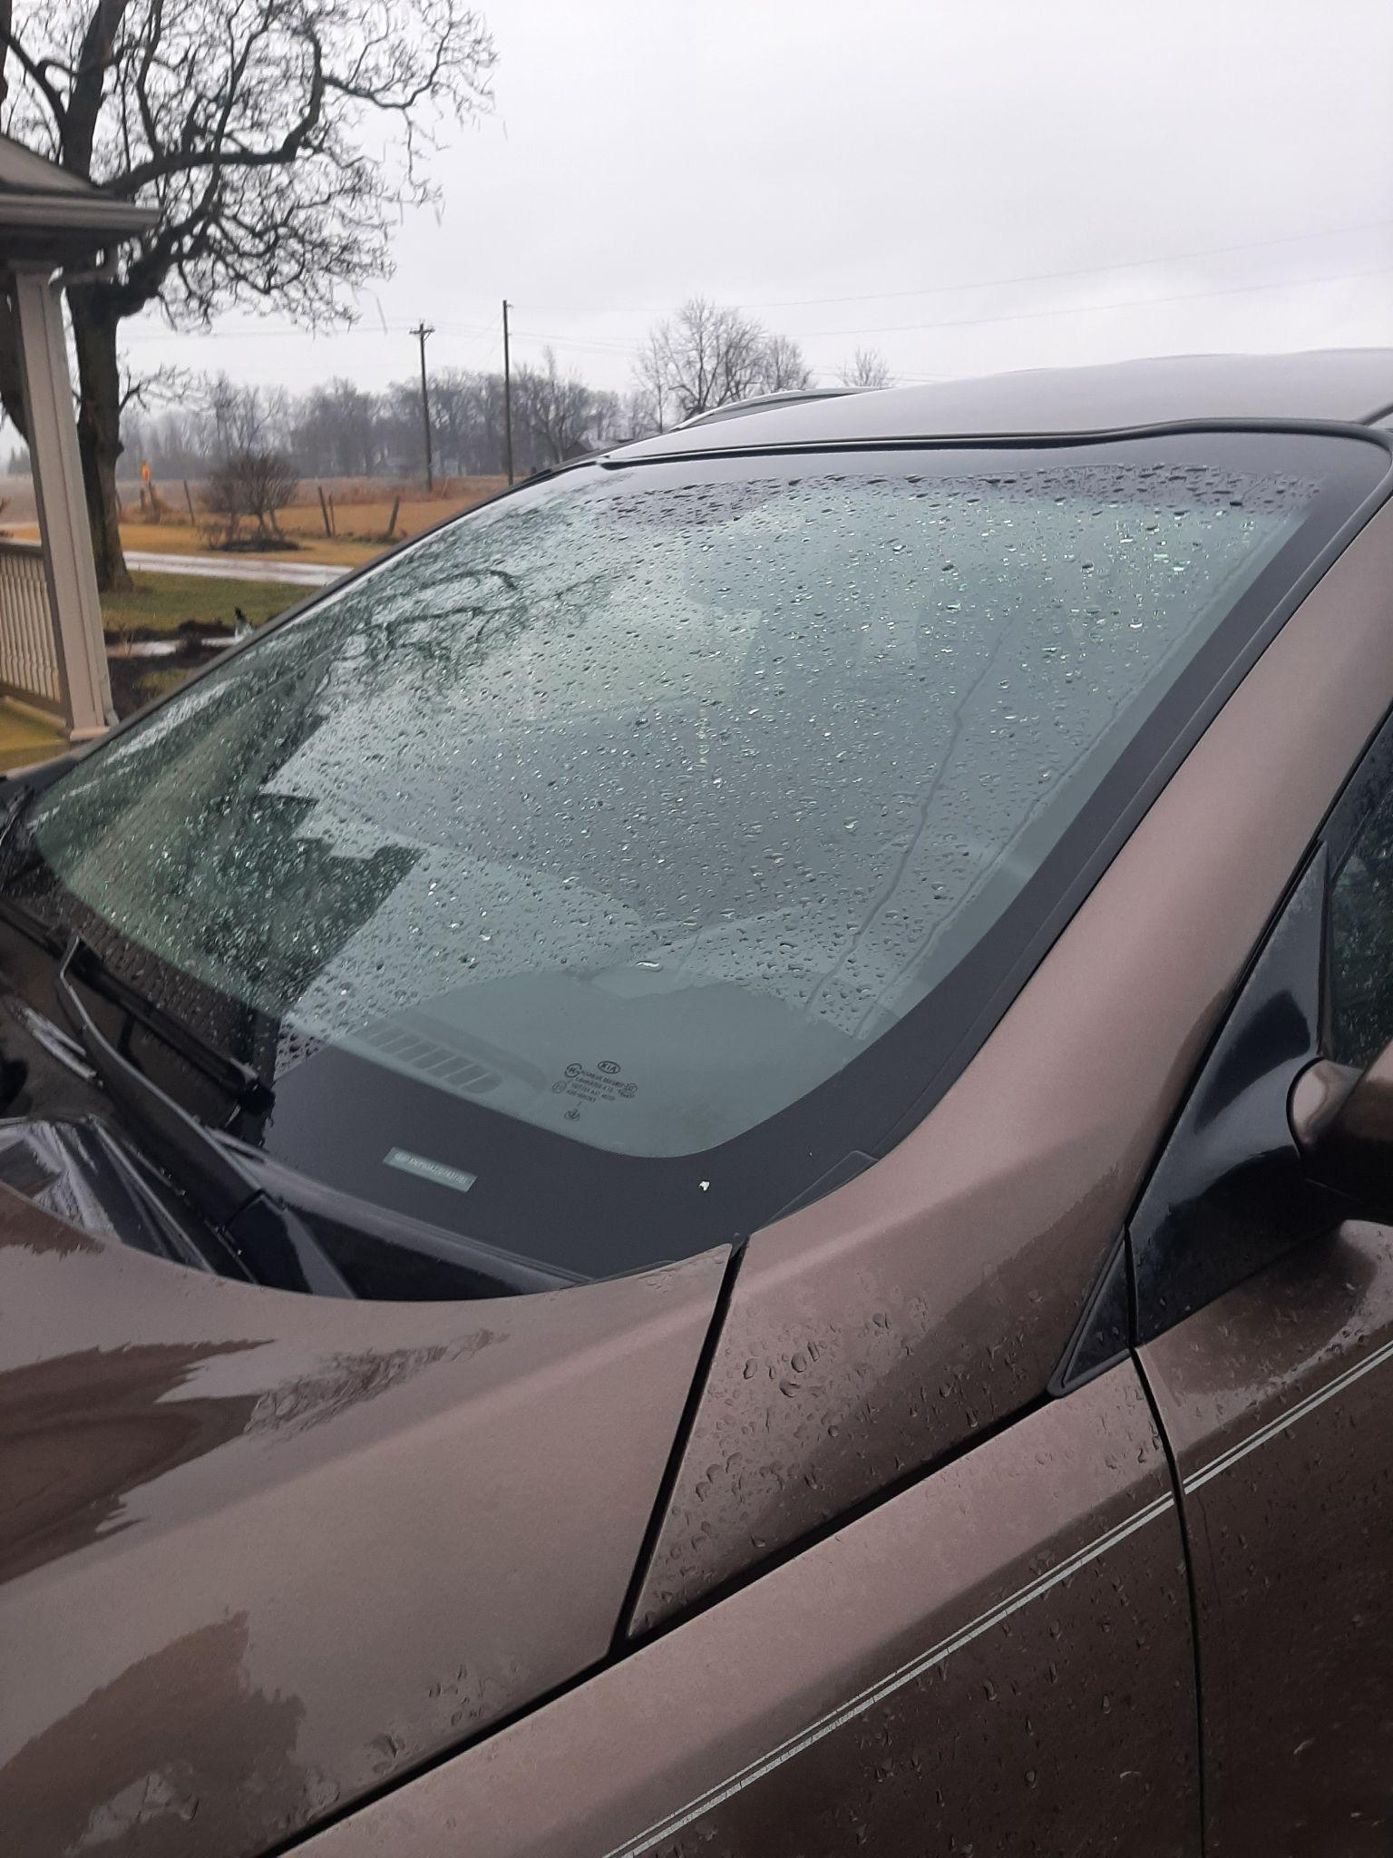
“Keep Your Windshield Clear So You Can Steer”
Emily Heitcamp
Anna High School
Anna, OH

Slide 7
“Babies Aren’t Maracas . . . Don’t Shake Them”
Zandria Platfoot
Anna High School
Anna, OH

Slide 8
“Don’t Make a Fast Drive Your Last Drive”
Ryan Noll
Anna High School
Anna, OH

Slide 9
“If You Smell Smoke, Get Woke!”
Maddy Freisthler
Anna High School
Anna, OH

Slide 10
“Even in Public, Predators Will Hunt!”
Cheyenne O’Reilly
Mahoning County Career & Technical Center
Struthers, OH

